Slide 1
A glimpse of LLM prompts: an example of COT

Slide 2
Motivation
Disclosing the importance of prompts
Pioneer in the improvement of LLM’s reasoning
Introduction into LLM’s thinking ability

Slide 3
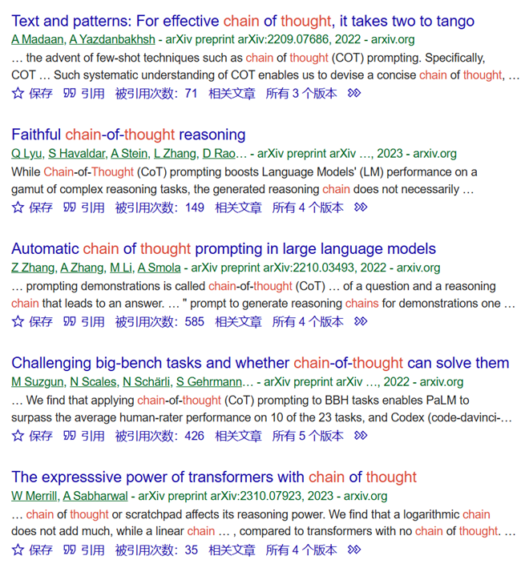
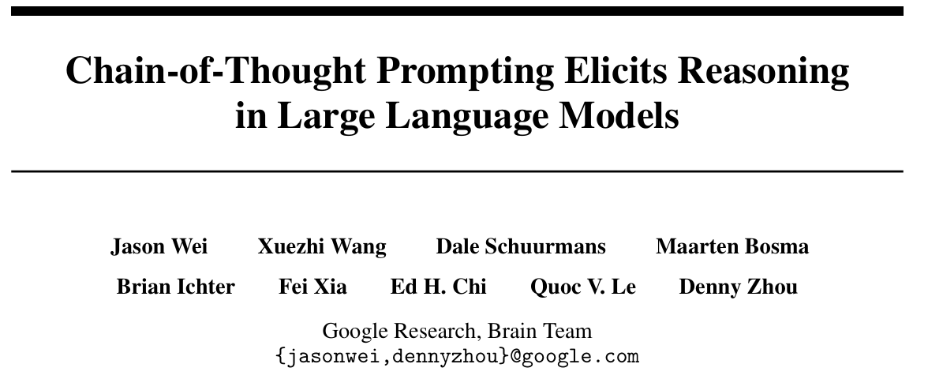
The introduction of COT prompting
7071 cites

Slide 4
Content
Abstract
Introduction
Method
Arithmetic Reasoning examination
Commonsense Reasoning examination
Symbolic Reasoning examination
Discussion and reflection

Slide 5
Abstract
Introduced COT prompting
Examination on up to five LLMs
Good performance in three kinds of tasks: Arithmetic Reasoning, Commonsense Reasoning and Symbolic Reasoning

Slide 6
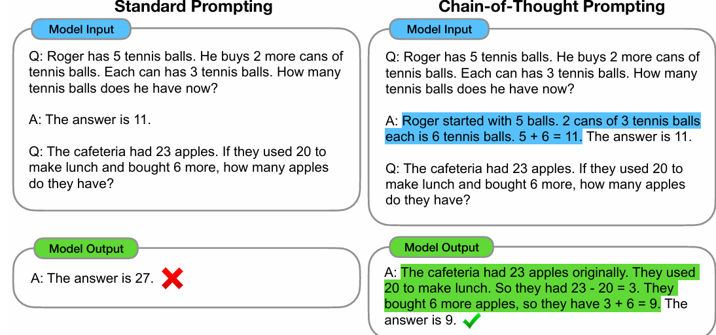

Slide 7
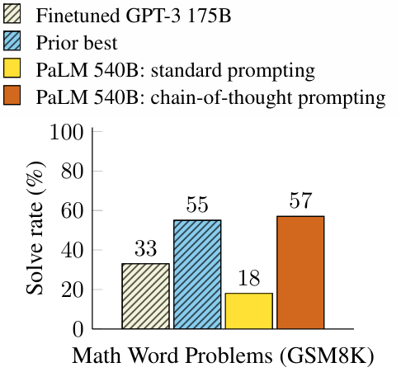
Introduction (Related work)
Comparison with two existing method:
Finetuning to generate natural language rationale
And few shot learning via prompting

Slide 8
Method
“It is typical to decompose the problem into intermediate steps and solve each before giving the final answer.”
Better distribution of computation
More interpretable
Wide usage
Easy to apply for LLMs

Slide 9
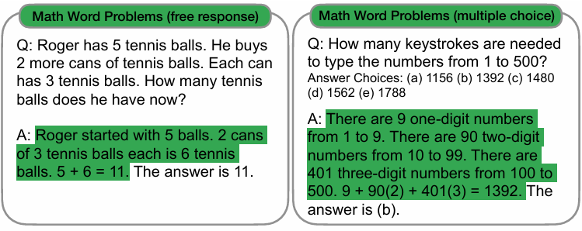
Examination: Arithmetic Reasoning
Benchmarks: GSM8K, SVAMP, ASDiv, AQuA, MAWPS
LLMs: GPT-3, LaMDA, PaLM, UL2 20B, Codex

Slide 10
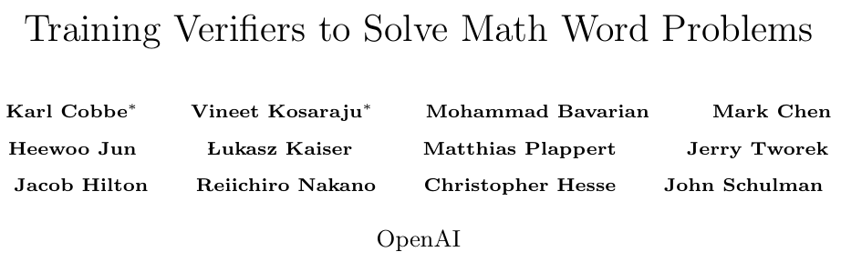
What is GSM8K
1652 cites

Slide 11
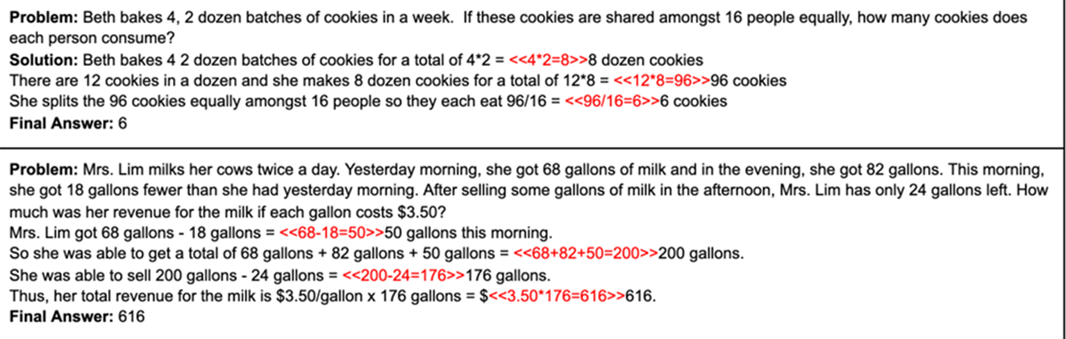
A benchmark and a verification method

Slide 12
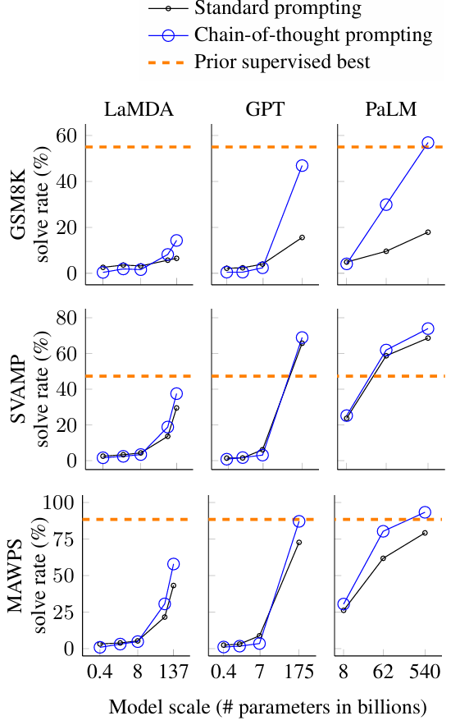
Examination: Arithmetic Reasoning
Outcome:
Scaling improves the performance
Ablation study showing natural language is necessary in prompting
Good Robustness

Slide 13
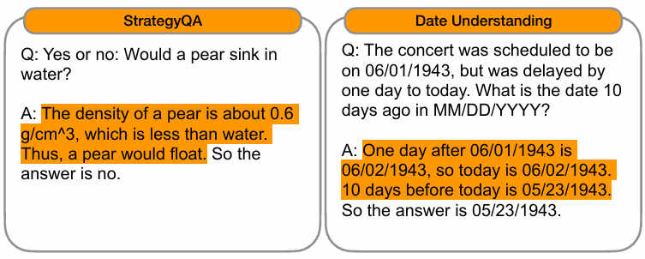
Examination: Commonsense Resoning
Benchmarks: CSQA, StrategyQA, Date and Sport from BIG-bench, SayCan
LLMs: PaLM, LaMDA, GPT-3

Slide 14
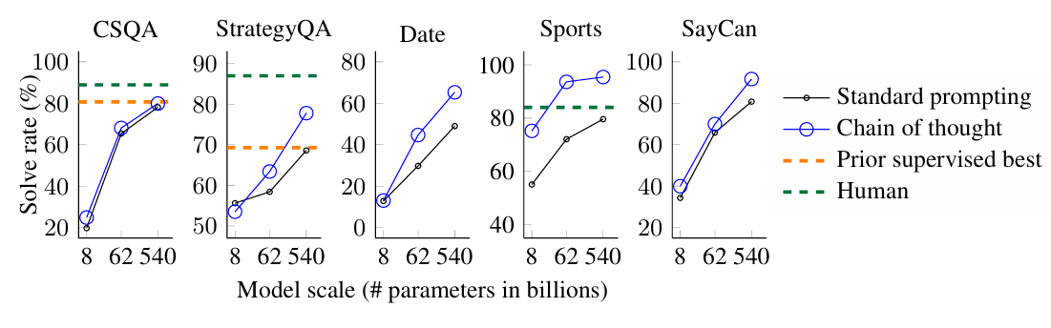
Examination: Commonsense Resoning
Outcome(PaLM):

Slide 15
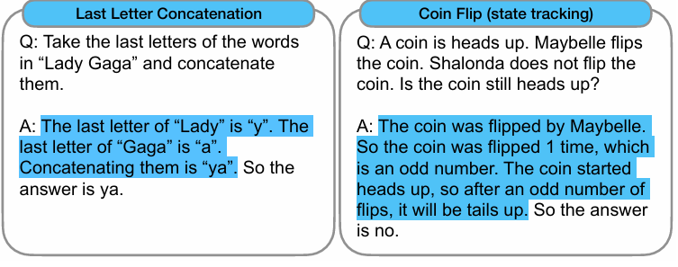
Examination: Symbolic Reasoning
Only two tasks
LLMs: PaLM, LaMDA

Slide 16
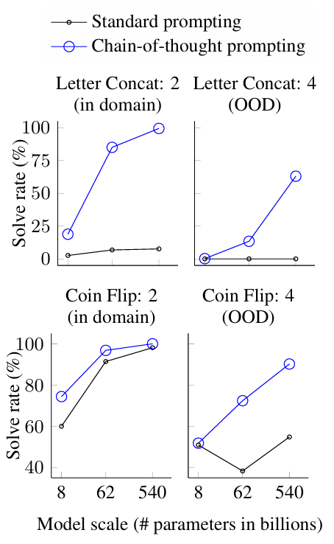
Examination: Symbolic Reasoning
Outcome:

Slide 17
Discussion and Reflection
Self reflection:
Not proving LLM’s “Reasoning”
More cost
Reasoning path may be wrong
Good performance only on LLMs

Slide 18
Reflection
Pioneer in prompting
Leading the exploration on LLM thinking
Imply LLM and human thoughts are similar
Benefiting not only producer but user of LLMs

Slide 19
Reference
Wei, J., Wang, X., Schuurmans, D., Bosma, M., Xia, F., Chi, E., ... & Zhou, D. (2022). Chain-of-thought prompting elicits reasoning in large language models. Advances in neural information processing systems, 35, 24824-24837.
Cobbe, K., Kosaraju, V., Bavarian, M., Chen, M., Jun, H., Kaiser, L., ... & Schulman, J. (2021). Training verifiers to solve math word problems. arXiv preprint arXiv:2110.14168.

